Slide 1

Life Expectancy Based on Various Health and Demographic Factors
Sai Raga Mounika Darimireddy
Venkata Ashwath Vennela
Anudeep Thumu
Yogitha Pollisetty

Slide 2
DATA SYNERGISTS
Sai Raga Mounika Darimireddy
Venkata Ashwath Vennela
Anudeep Thumu
Yogitha Pollisetty

Slide 3





Overview
Dataset Introduction
Dataset Preprocessing
Methodology
Results
Conclusion

Slide 4
Introduction
In this exploration of the Life Expectancy dataset, we aim to understand the factors that significantly impact life expectancy globally. The main goal is figuring out which health indicators can accurately predict life expectancy.
Firstly, by exploring various health and demographic indicators, we can better understand how these factors relate to life expectancy. Secondly, by building models to predict life expectancy, we can improve the accuracy of these predictions. Identifying the most important variables allows us to enhance these models, making them reliable.
Lastly, our exploration aims to reveal the diverse influences on life expectancy. Factors like economic indicators (GDP), disease prevalence (HIV/AIDS, Measles), healthcare infrastructure (immunization coverage), and social determinants (education, income distribution) all play a role.

Slide 5
Data Description Summary
Scope and Time Frame:
This dataset likely covers health and demographic information for various countries across the globe.
Features:
The dataset includes over 1650 rows with a mix of categorical and numerical variables offering insights into various health and demographic aspects.
Demographics: Country, Year, Population
Health Indicators: Life expectancy, Adult Mortality, Infant Deaths, Under-five deaths, BMI (Body Mass Index), Thinness (various age groups)
Healthcare: Hepatitis B, Measles, Polio, Diphtheria, HIV/AIDS (presence or vaccination rates)
Socioeconomic factors: Total expenditure, Percentage expenditure on Alcohol, Income composition of resources, GDP (Gross Domestic Product), Schooling

Slide 6
Data Description
Country: The name of the country for which the data is recorded.
Year: The year in which the data was collected, representing the temporal aspect of the dataset.
Status: The development status of the country, often categorized as "Developed" or "Developing." This indicates the overall economic and social development of the country.
Life Expectancy: The average number of years a person born in that year can expect to live, serving as an important health indicator.
Adult Mortality: The probability of dying between the ages of 15 and 60 per 1,000 population.
Infant Deaths: The number of infant deaths per 1,000 live births.
Alcohol: The average alcohol consumption in liters per capita.
Percentage Expenditure: Health expenditure as a percentage of the country's GDP.
Hepatitis B: Immunization coverage for Hepatitis B in the country.
Measles: The number of reported cases of measles per 1,000 population.
BMI: The average Body Mass Index (BMI) of the population.
Polio: Immunization coverage for Polio in the country.
Under-Five Deaths: The number of deaths of children under the age of five per 1,000 live births.
Total Expenditure: The total health expenditure as a percentage of the country's GDP.
Diphtheria: Immunization coverage for Diphtheria in the country.
HIV/AIDS: The prevalence of HIV/AIDS as a percentage of the population.
GDP: Gross Domestic Product, representing the economic output of the country.
Population: The total population of the country.
Thinness 1-19 Years: Prevalence of thinness among children and adolescents aged 1-19.
Thinness 5-9 Years: Prevalence of thinness among children aged 5-9.
Income Composition of Resources: A composite index reflecting the income distribution and access to resources in the country.
Schooling: The average number of years of schooling received by the population.

Slide 7
Data Pre-Processing
Removed Unnecessary Columns: Columns such as “Country” and “Year” were removed from the dataset as they do not contribute the analysis
Checking for Missing Values: A check was performed to identify any missing values in the dataset. Upon verification, no missing values were found.
Created new variable: A new column continent was created. This column was used to predict life expectancy of the continent
Initially the dataset consists of 1650 records with 22 columns after pre-processing it becomes 1650 records with 21 columns.

Slide 8
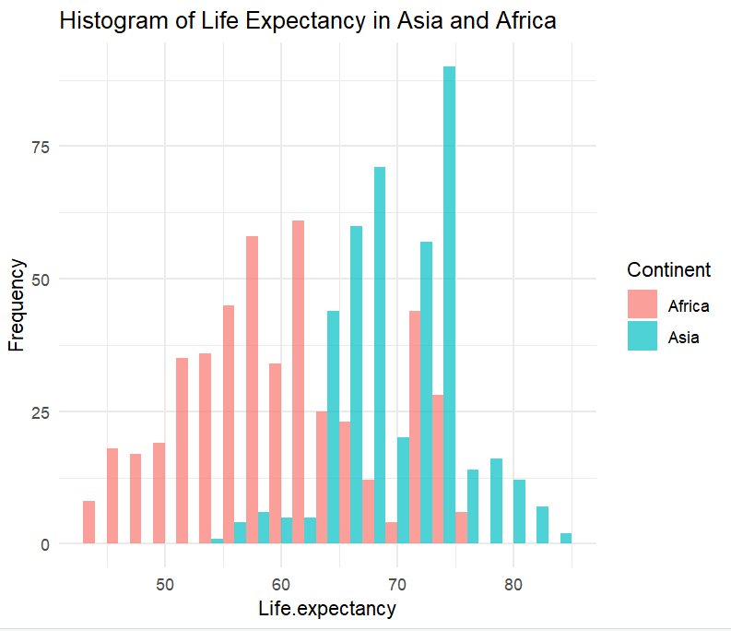
Histogram of Life Expectancy in Asia And Africa
The histogram reveals a bimodal distribution of life expectancy in Asia and Africa. A bimodal distribution has two peaks, and this histogram appears to have peaks around 60-65 years and 70-75 years. This suggests that there might be two groups of countries in Asia and Africa, one with a lower average life expectancy and another with a higher average life expectancy.

Slide 9
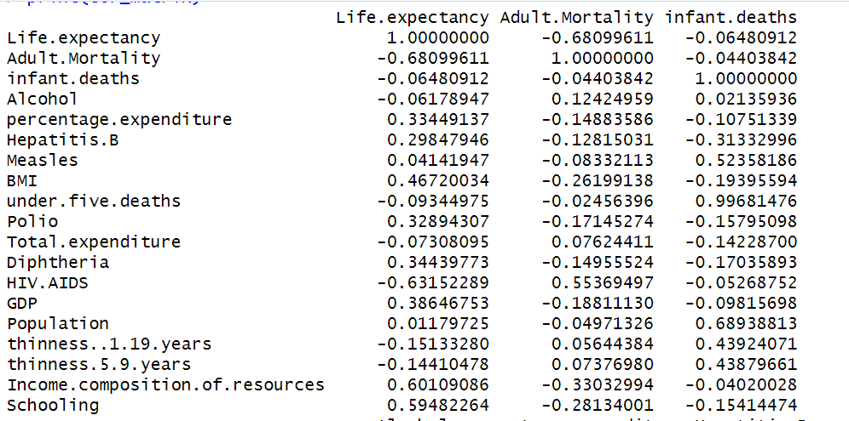
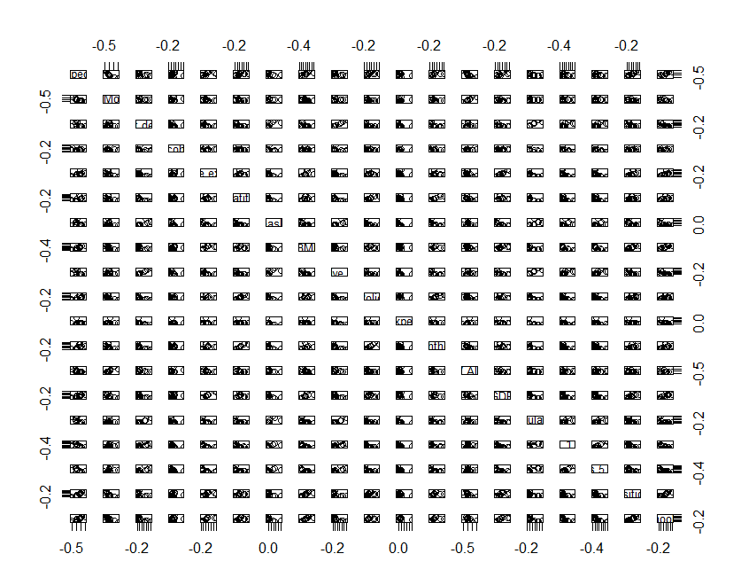
Correlation Matrix
This correlations suggest that higher values in Adult Mortality, HIV/AIDS prevalence, and Infant deaths are associated with lower life expectancy.

Slide 10
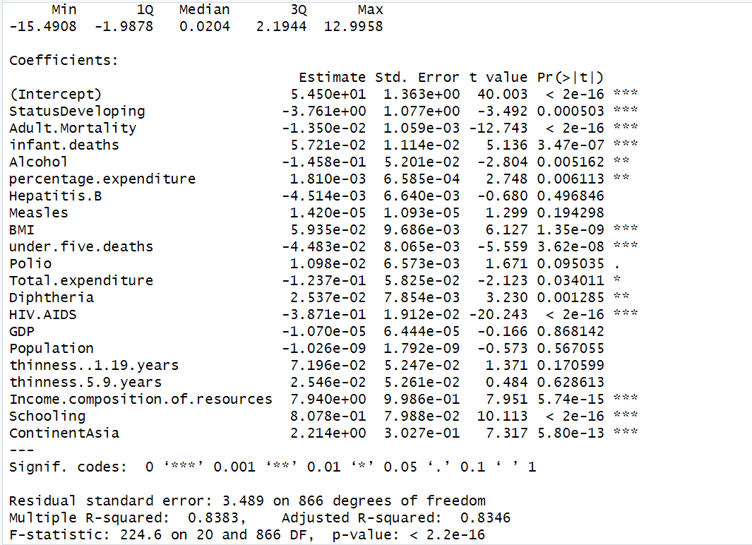
Simple Linear Model
All the variables from the dataset are used to create a simple linear model
The adjusted R-squared value of 0.8346 indicates that approximately 83.46% of the variance in life expectancy is explained by the predictors in the model.

Slide 11
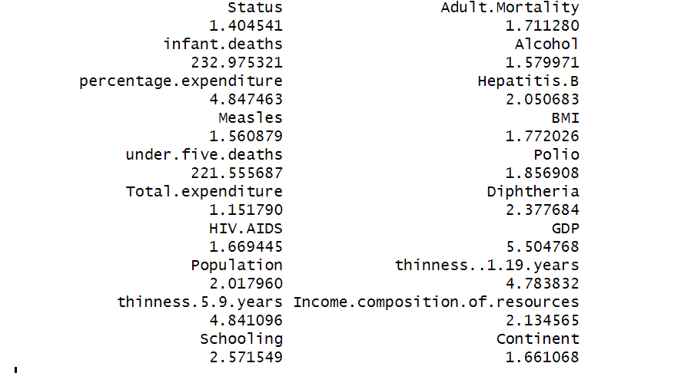
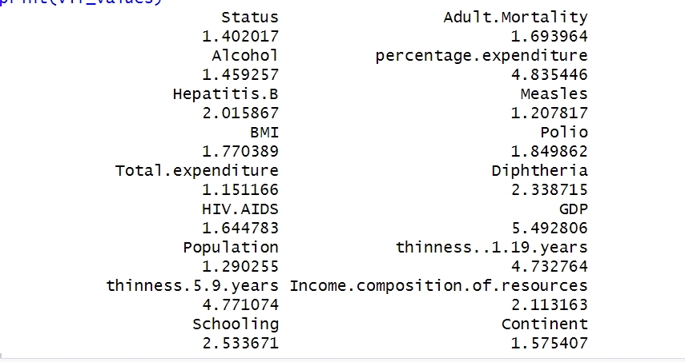
Performing VIF
Performing VIF
Peforming VIF Values
Before removing values which are above 10
After removing the values which are above 10

Slide 12
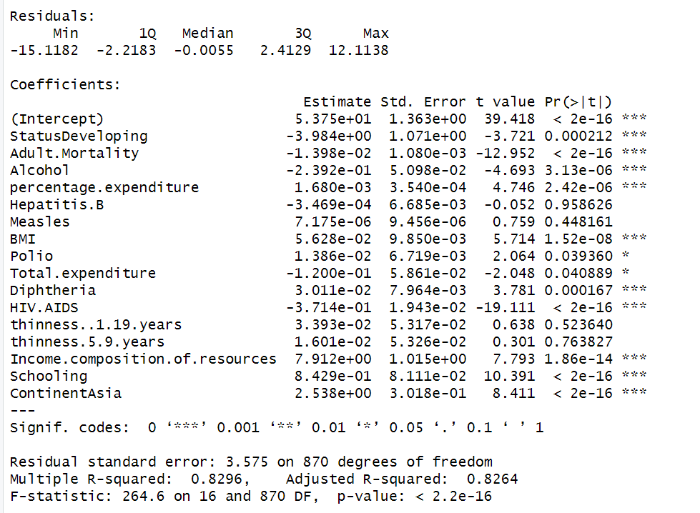
Step Wise Regression
Performed Stepwise backward elimination to identify least significant variable based on p-value and remove them to improve the performance of the model
The adjusted R-squared for the final model is 0.8264, suggesting that approximately 82.64% of the variability in life expectancy is explained by the predictor variables included in the model.

Slide 13
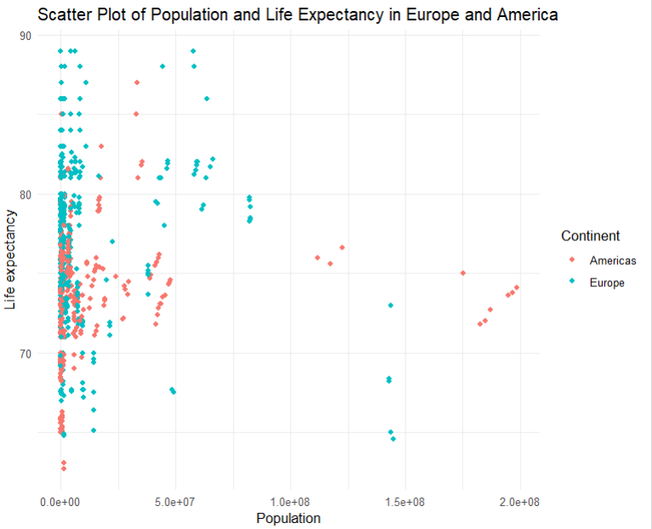
Plots
This scatter plot shows life expectancy compared to population in Europe and America. The x-axis represents population (0 to 200 million likely). The y-axis shows life expectancy (70 to 90 years). Countries with lower populations (0 to 100 million likely) tend to have higher life expectancies (78 to 90 years). Conversely, countries with higher populations (over 100 million likely) have lower life expectancies (70 to 80 years). This suggests a negative correlation between population and life expectancy in Europe and America.

Slide 14

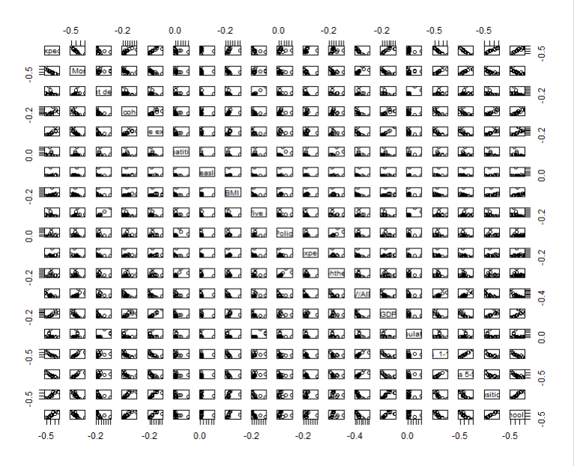
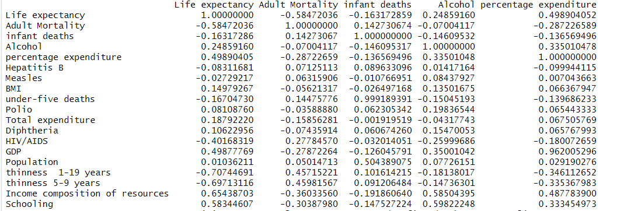
Correlation Matrix ​
Life expectancy has a negative correlation with adult mortality, HIV/AIDS , and infant deaths. This means places with higher life expectancy tend to have lower rates of adult mortality, HIV/AIDS, and infant deaths.

Slide 15
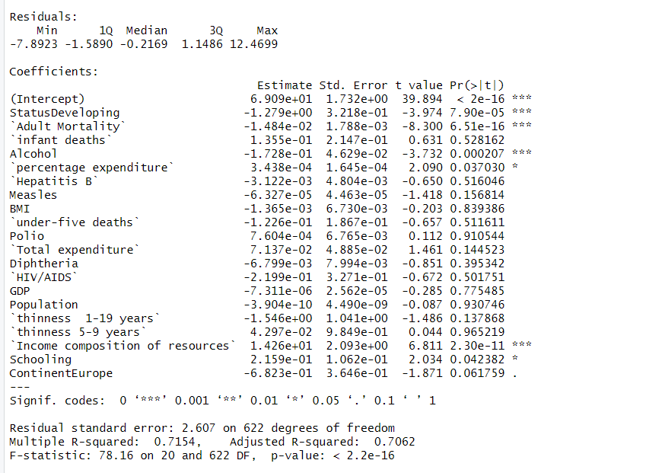
Simple Linear Model
All the variables from the dataset are used to create a simple linear model.
The adjusted R-squared value of 0.762 indicates that approximately 76% of the variance in life expectancy is explained by the predictors in the model.

Slide 16
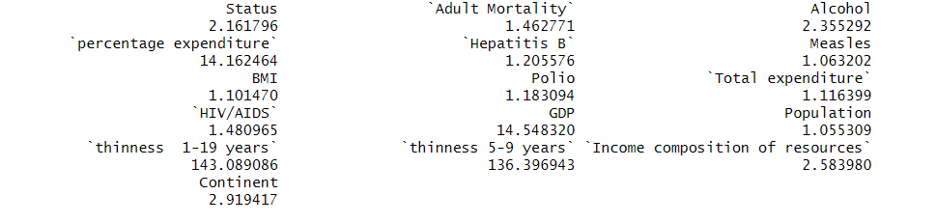
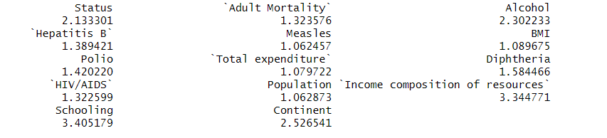
The vif values before removing values that are above 10
The vif values after removing values that are above 10

Slide 17
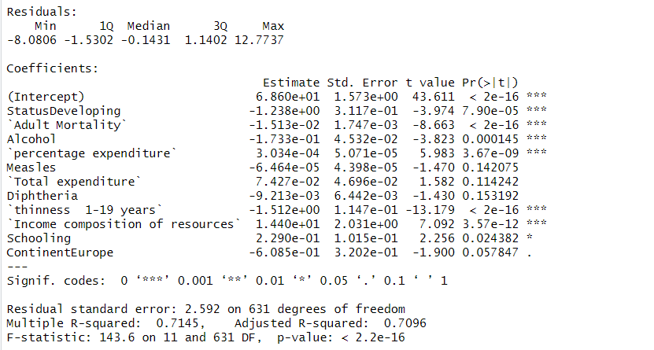
Step Wise Regression
We used a step-by-step process to remove unimportant factors affecting life expectancy. This improved the model's performance. The final model explains 70% of the variation in life expectancy based on the remaining factors.

Slide 18
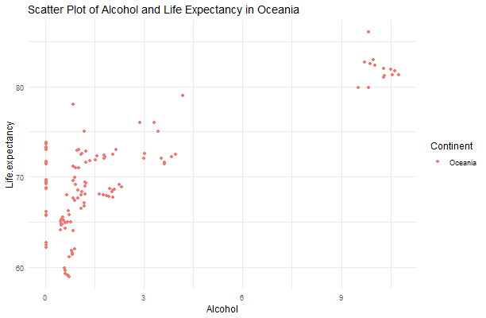
Scatter Plot of Alcohol and Life Expectancy in Oceania
Each data point represents a country in Oceania.
General trend: There appears to be a negative correlation between alcohol consumption and life expectancy. This means that countries with higher alcohol consumption tend to have lower life expectancy.
Data points:
Nauru has the highest alcohol consumption (around 6 liters per year) and the lowest life expectancy (around 60 years).
Australia and New Zealand have a lower alcohol consumption (around 3 liters per year) and a higher life expectancy (around 80 years).
This graph only shows an association between the two variables. Other factors, such as smoking, diet, and access to healthcare, can also influence life expectancy. The data points represent averages for each country. Individual variations within each country would not be captured in this graph. Overall, this graph suggests that there might be a link between higher alcohol consumption and lower life expectancy in Oceania. However, it is important to consider other factors that can influence life expectancy.

Slide 19
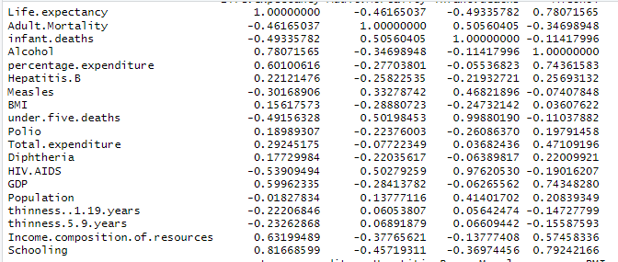
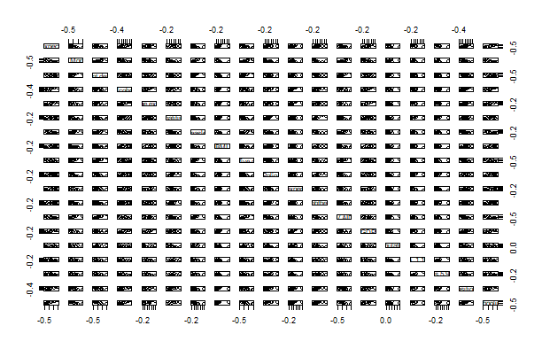
Correlation Matrix

Slide 20
Correlation Matrix
The correlation matrix in the previous slide shows the relationship between various health and economic factors.
Each cell contains a correlation coefficient, which is a number between -1 and 1. A coefficient of 1 indicates a perfect positive correlation, 0 indicates no correlation, and -1 indicates a perfect negative correlation.
Here are some examples of what the values in the table might indicate:
A correlation coefficient of 0.78 between "Life expectancy" and "Alcohol consumption" suggests a positive correlation. This means that as life expectancy increases, alcohol consumption also tends to increase.
A correlation coefficient of -0.46 between "Life expectancy" and "Adult Mortality" indicates a negative correlation. This means that as life expectancy increases, adult mortality tends to decrease.

Slide 21
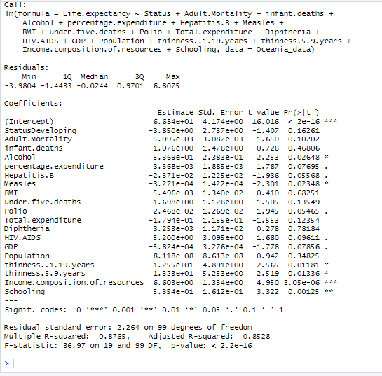
Linear Regression Model Summary
This linear regression model aims to predict life expectancy based on various predictor variables such as country status (developing or developed), adult mortality rate, infant deaths, alcohol consumption, healthcare indicators (Hepatitis B, measles immunization, polio immunization, diphtheria immunization), economic factors (GDP, income composition of resources), demographic factors (population), and other health-related indicators (BMI, HIV/AIDS prevalence, thinness rates, schooling, total expenditure on health, percentage of GDP expenditure)
The coefficient estimates indicate the expected change in life expectancy with a one-unit change in each predictor, holding other variables constant. Significant predictors, with p-values less than 0.05, include alcohol consumption, measles immunization, thinness in children under 5 years, thinness in children aged 5 to 9 years, income composition of resources, and schooling. The R-squared value of 0.8765 suggests that approximately 87.65% of the variance in life expectancy is explained by the model. The residual standard error, around 2.264 years, measures the average deviation of observed values from predicted values. The adjusted R-squared, accounting for the number of predictors, is 0.8528. The F-statistic, with a low p-value (< 2.2e-16), indicates the overall model's statistical significance. Overall, the model provides valuable insights into the factors influencing life expectancy in the Oceania region, highlighting the importance of healthcare, education, and economic stability in determining life expectancy outcomes.

Slide 22
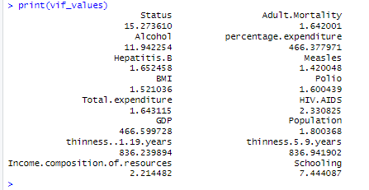
Variance Inflation Factor Values
Variables: Each row and column label represents a variable in the dataset. Some of the variables include "Adult.Mortality", "Alcohol", "BMI", "Total.expenditure", and "GDP".
Correlation Coefficients: The values in the table represent the correlation coefficients between each pair of variables. These coefficients range from -1 to 1.
  A correlation coefficient closer to 1 indicates a strong positive correlation. This means that as the value of one variable increases, the value of the other variable also tends to increase.
  A correlation coefficient closer to -1 indicates a strong negative correlation. This means that as the value of one variable increases, the value of the other variable tends to decrease.
  A correlation coefficient closer to 0 indicates weak or no correlation between the two variables.
  Overall the model demonstrates a good fit (Multiple R-squared: 0.8765), indicating that approximately 87.65% of the variance in life expectancy is explained by the predictors included. The adjusted R-squared (0.8528) accounts for the number of predictors, providing a more accurate measure of the model's goodness of fit. Moreover, the F-statistic (36.97) with an extremely low p-value (< 2.2e-16) underscores the overall statistical significance of the model, indicating that the predictors collectively have a significant effect on life expectancy in Oceania.

Slide 23
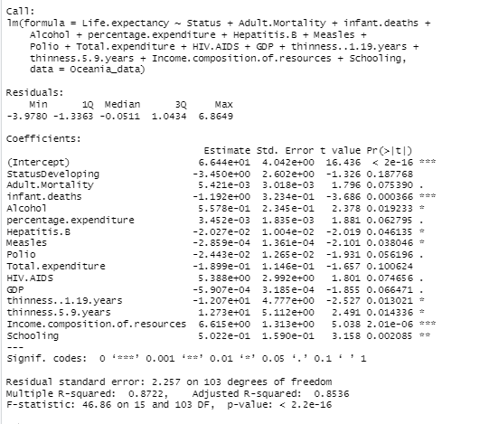
Final Model Summary
Ininitally I removed variables infant deaths, removing underdeaths ,Dipherteria, schooling and obtained adjusted r square of the model of 0.8538 which indicates better than the initial model. Here is the summary of the final model below.
Residuals: These are the differences between the observed values of the dependent variable (life expectancy) and the values predicted by the model. The summary provides statistics such as minimum, 1st quartile, median, 3rd quartile, and maximum of these residuals.
Significance Codes: These codes indicate the level of significance of each predictor variable. The commonly used significance levels are denoted by '', '', and '', representing p-values less than 0.05, 0.01, and 0.001 respectively.
Residual Standard Error: This is an estimate of the standard deviation of the residuals. It provides a measure of the typical size of the residuals.
Multiple R-squared: This value indicates the proportion of variance in the dependent variable (life expectancy) that is explained by the independent variables included in the model. In this case, approximately 87.22% of the variance in life expectancy is explained by the predictor variables.
Adjusted R-squared: This value adjusts the R-squared value for the number of predictors in the model. It penalizes the inclusion of unnecessary variables. In this model, the adjusted R-squared is approximately 85.36%.
F-statistic: This is a test statistic that assesses the overall significance of the regression model. It evaluates whether at least one of the predictor variables has a non-zero coefficient. The associated p-value indicates whether the overall model is statistically significant. Overall, this regression model suggests that the included predictor variables collectively have a strong association with life expectancy in Oceania countries, as indicated by the high R-squared value and significant coefficients.

Slide 24
Predictive analysis of life expectancy over various continents in the
Health & Demographics dataset.
Sai Raga Mounika

Slide 25
Data Preprocessing
Handling missing values
Renaming variables
> Cleaned_Health_Data <- rename(Health_Data, Life_Expectancy = Life.expectancy, Adult_Mortality = Adult.Mortality,Infant_Deaths = infant.deaths, Percentage_Expenditure = percentage.expenditure, Hepatitis_B = Hepatitis.B, Under_5_Deaths = under.five.deaths, Total_Expenditure = Total.expenditure, HIV_AIDS = HIV.AIDS, Thinness_10to19_Years = thinness..1.19.years, Thinness_5to9_Years = thinness.5.9.years, ICOR = Income.composition.of.resources)
Integration of 'Continent' Information
# Install and load the 'countrycode' package
> install.packages("countrycode")
# Create a new column 'Continent' using countrycode to get the continent information
> Cleaned_Health_Data$Continent <- countrycode(Cleaned_Health_Data$Country, "country.name", "continent")
Reordering the columns
> library(dplyr)
> Cleaned_Health_Data <- select(Cleaned_Health_Data, Country, Year, Status, Continent, Adult_Mortality, Infant_Deaths, Under_5_Deaths, Alcohol, HIV_AIDS, Hepatitis_B, Polio, Diphtheria, Measles, BMI, Thinness_5to9_Years, Thinness_10to19_Years, GDP, Population, Percentage_Expenditure, Total_Expenditure, ICOR, Schooling, Life_Expectancy )

Slide 26
Variables
Country : Country
Year : Year
Status : The country’s development status, whether "Developed" or "Developing.”
Life Expectancy : Average lifespan in age(Years).
Adult Mortality : Number of deaths per 1,000 population.
Infant Deaths : Number of infant deaths per 1,000 live births.
Alcohol : Average alcohol consumption in liters per capita.
Percentage Expenditure : Health expenditure as a percentage of a country's GDP.
Hepatitis B : Measure immunization coverage for Hepatitis B.
Measles : Number of reported cases per 1,000 population.
BMI : The average Body Mass Index.
Under-Five Deaths : Number of deaths under age five per 1,000 live births.
Polio : Immunization coverage for Polio.
Total Expenditure : Total health expenditure as a percentage of GDP.
Diphtheria : Immunization coverage for Diphtheria.
HIV/AIDS : Prevalence of HIV/AIDS as a percentage of the population.
GDP : Gross Domestic Product data.
Population : Witness the ebb and flow of a nation's populace.
Thinness 1-19 Years : Prevalence of thinness among adolescents aged 1-19.
Thinness 5-9 Years : Thinness among children aged 5-9.
ICOR : Composite index reflecting income distribution and resource access.
Schooling : Average years of schooling.

Slide 27
Data Preprocessing
Converting categorical variables into factors
> Cleaned_Health_Data$Status <- as.factor(Cleaned_Health_Data$Status)
> Cleaned_Health_Data$Country <- as.factor(Cleaned_Health_Data$Country)
> Cleaned_Health_Data$Continent <- as.factor(Cleaned_Health_Data$Continent)
Removing the variables that do not provide additional information to predict the response variable ‘Life Expectancy.
‘Country’ and ‘Year’ are removed from our dataset as part of the analysis.

Slide 28
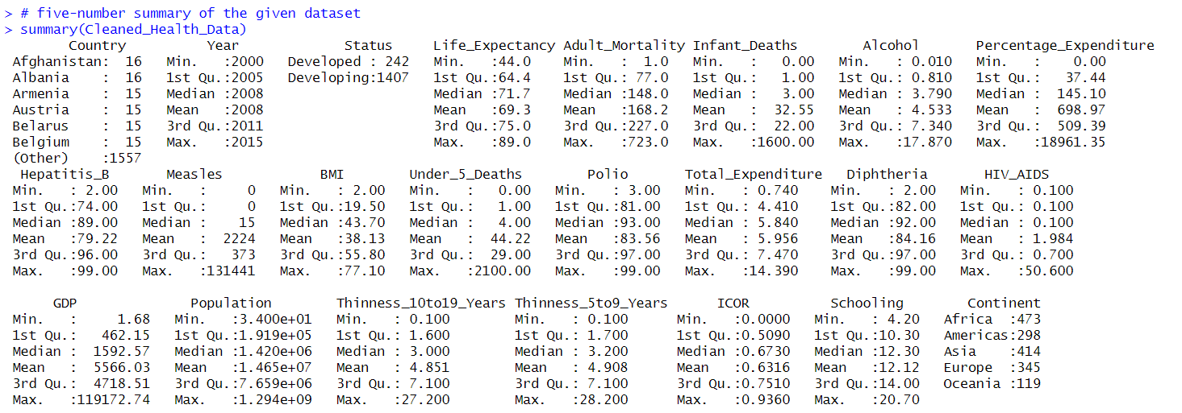
Summary Statistics

Slide 29
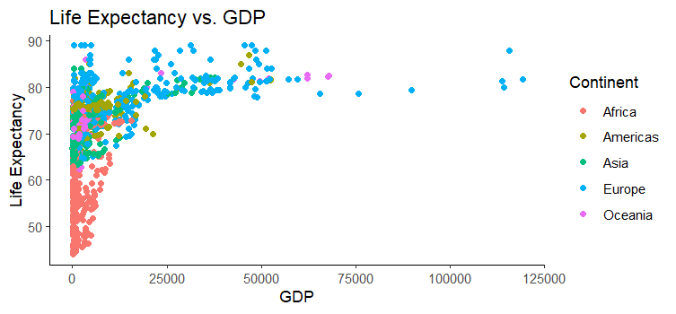
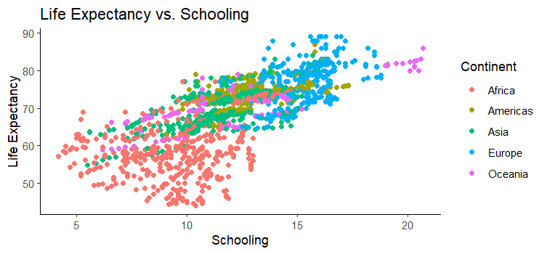
SCATTERPLOTS

Slide 30
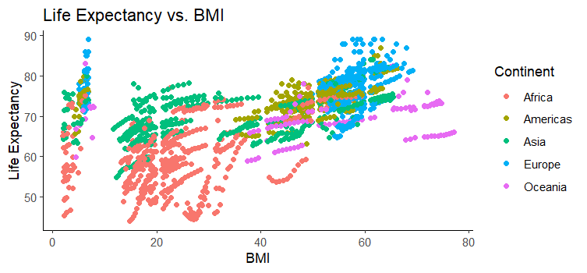
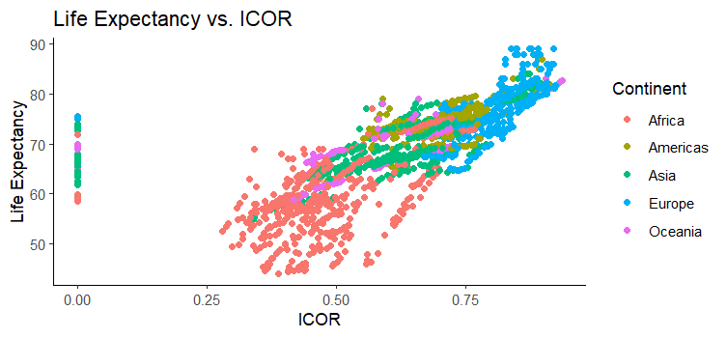

Slide 31
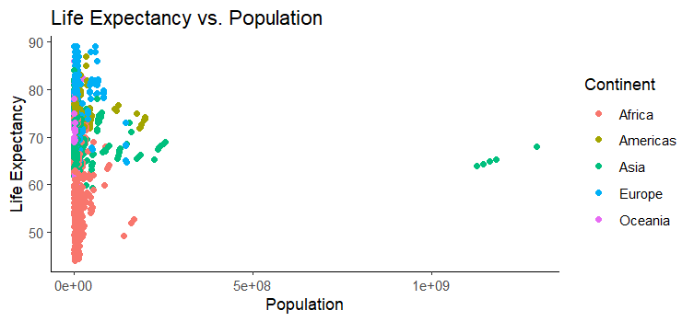
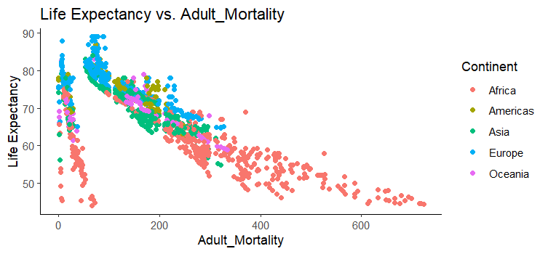

Slide 32
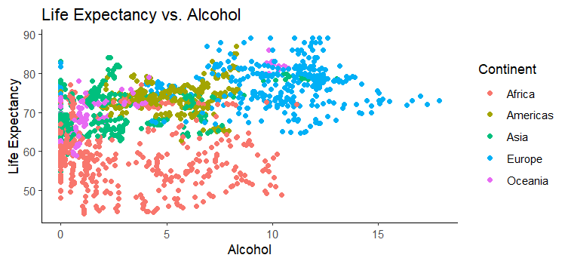
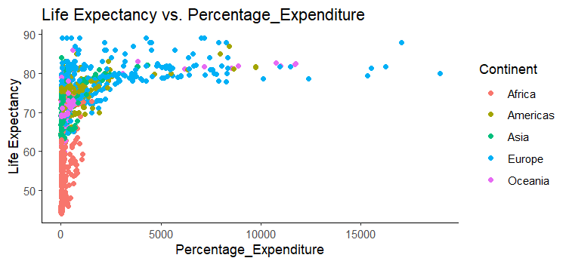

Slide 33
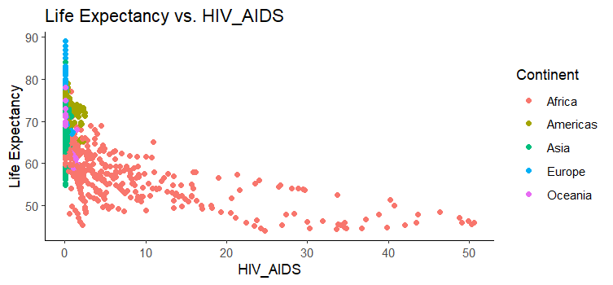

Slide 34
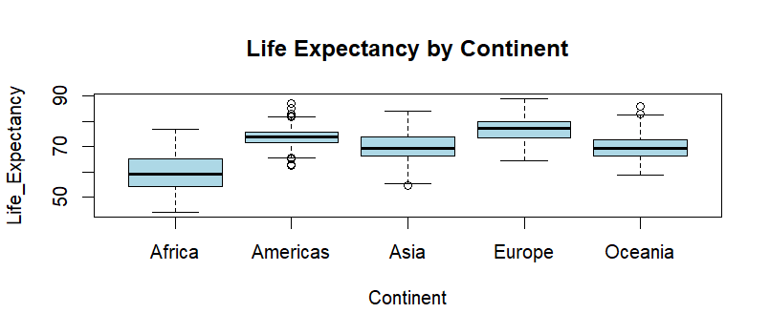
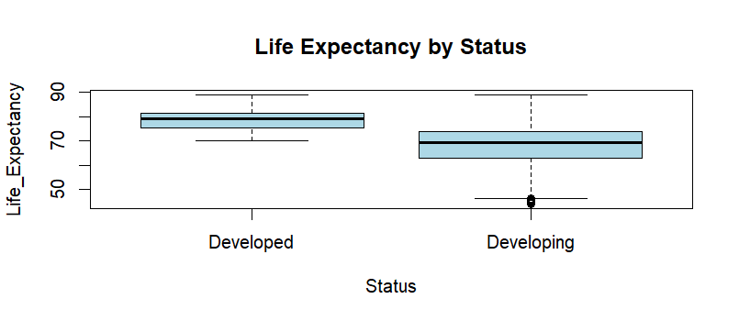
BOX PLOTS

Slide 35
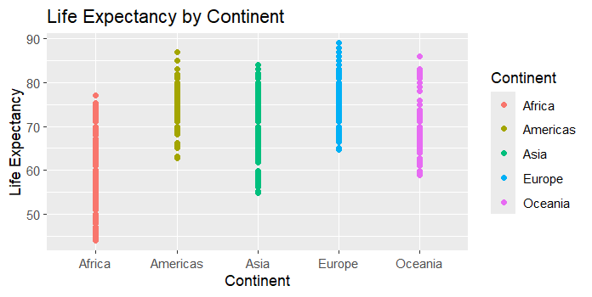
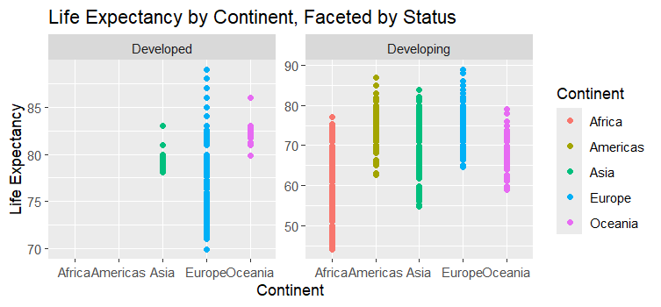

Slide 36
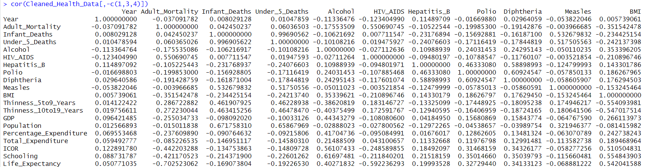
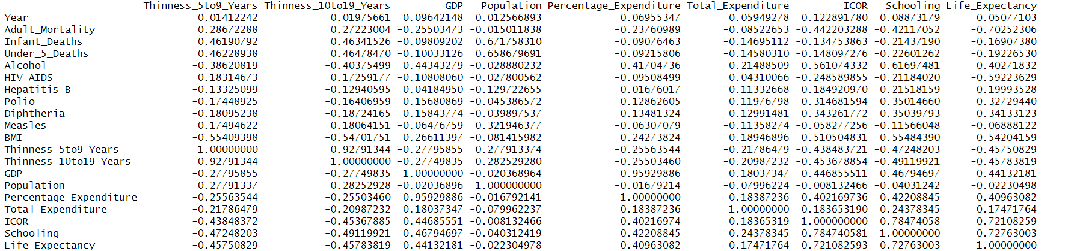
MULTICOLLINEARITY - Correlation Matrix

Slide 37
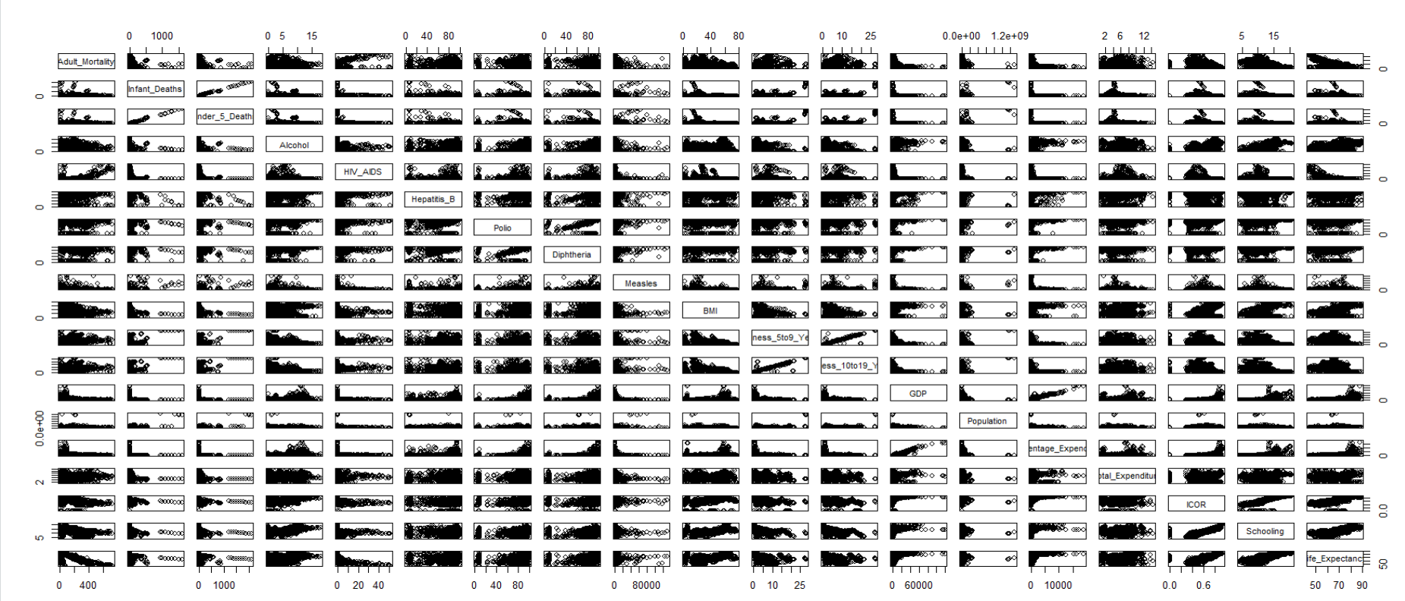
Correlation Plot

Slide 38
Linear Regression Model
model <- lm(Life_Expectancy ~ ., data = Cleaned_Health_Data)
summary(model)
Call:
lm(formula = Life_Expectancy ~ ., data = Cleaned_Health_Data)
Residuals:
Min 1Q Median 3Q Max
-15.8298 -2.2417 0.1148 2.0961 12.3893
Coefficients:
Estimate Std. Error t value Pr(>|t|)
(Intercept) 5.485e+01 8.171e-01 67.124 < 2e-16 ***
StatusDeveloping -1.636e+00 3.622e-01 -4.517 6.71e-06 ***
ContinentAmericas 4.271e+00 3.345e-01 12.769 < 2e-16 ***
ContinentAsia 2.775e+00 2.823e-01 9.827 < 2e-16 ***
ContinentEurope 3.191e+00 4.152e-01 7.686 2.60e-14 ***
ContinentOceania 1.332e+00 4.258e-01 3.128 0.00179 **
Adult_Mortality -1.523e-02 9.047e-04 -16.831 < 2e-16 ***
Infant_Deaths 5.856e-02 1.048e-02 5.587 2.70e-08 ***
Under_5_Deaths -4.524e-02 7.580e-03 -5.969 2.93e-09 ***
Alcohol -1.868e-01 3.584e-02 -5.212 2.11e-07 ***
HIV_AIDS -3.733e-01 1.774e-02 -21.050 < 2e-16 ***
Hepatitis_B -6.107e-03 4.236e-03 -1.442 0.14963
Polio 8.919e-03 4.878e-03 1.828 0.06768 .
Diphtheria 1.308e-02 5.638e-03 2.319 0.02050 *
Measles 1.309e-06 1.034e-05 0.127 0.89929
BMI 2.313e-02 5.887e-03 3.928 8.92e-05 ***
Thinness_5to9_Years -5.048e-02 5.035e-02 -1.002 0.31627
Thinness_10to19_Years 8.515e-03 5.038e-02 0.169 0.86580
GDP 2.103e-05 2.722e-05 0.773 0.43982
Population -6.374e-10 1.659e-09 -0.384 0.70079
Percentage_Expenditure 3.392e-04 1.730e-04 1.960 0.05012 .
Total_Expenditure 4.125e-02 3.907e-02 1.056 0.29126
ICOR 8.265e+00 8.084e-01 10.224 < 2e-16 ***
Schooling 8.262e-01 5.756e-02 14.352 < 2e-16 ***
---
Signif. codes: 0 ‘***’ 0.001 ‘**’ 0.01 ‘*’ 0.05 ‘.’ 0.1 ‘ ’ 1
Residual standard error: 3.396 on 1625 degrees of freedom
Multiple R-squared: 0.8531, Adjusted R-squared: 0.851
F-statistic: 410.3 on 23 and 1625 DF, p-value: < 2.2e-16
> summary(final_model)
Call:
lm(formula = Life_Expectancy ~ Status + Adult_Mortality + Infant_Deaths +
Under_5_Deaths + Alcohol + Percentage_Expenditure + BMI +
Polio + Diphtheria + HIV_AIDS + Thinness_5to9_Years + ICOR +
Schooling + Continent, data = Cleaned_Health_Data)
Residuals:
Min 1Q Median 3Q Max
-16.0057 -2.2009 0.1094 2.1074 12.3786
Coefficients:
Estimate Std. Error t value Pr(>|t|)
(Intercept) 54.9298997 0.7755889 70.823 < 2e-16 ***
StatusDeveloping -1.6070430 0.3589032 -4.478 8.07e-06 ***
Adult_Mortality -0.0153076 0.0009020 -16.971 < 2e-16 ***
Infant_Deaths 0.0581396 0.0098237 5.918 3.96e-09 ***
Under_5_Deaths -0.0449376 0.0072852 -6.168 8.68e-10 ***
Alcohol -0.1872329 0.0355395 -5.268 1.56e-07 ***
Percentage_Expenditure 0.0004767 0.0000561 8.497 < 2e-16 ***
BMI 0.0226790 0.0058473 3.879 0.000109 ***
Polio 0.0080300 0.0048003 1.673 0.094560 .
Diphtheria 0.0096180 0.0050789 1.894 0.058441 .
HIV_AIDS -0.3701773 0.0176009 -21.032 < 2e-16 ***
Thinness_5to9_Years -0.0478565 0.0269605 -1.775 0.076074 .
ICOR 8.2859429 0.8039707 10.306 < 2e-16 ***
Schooling 0.8316711 0.0568180 14.637 < 2e-16 ***
ContinentAmericas 4.2769100 0.3289078 13.003 < 2e-16 ***
ContinentAsia 2.7650899 0.2806507 9.852 < 2e-16 ***
ContinentEurope 3.2504223 0.4115620 7.898 5.17e-15 ***
ContinentOceania 1.2869572 0.4199960 3.064 0.002218 **
---
Signif. codes: 0 ‘***’ 0.001 ‘**’ 0.01 ‘*’ 0.05 ‘.’ 0.1 ‘ ’ 1
Residual standard error: 3.393 on 1631 degrees of freedom
Multiple R-squared: 0.8527, Adjusted R-squared: 0.8512
F-statistic: 555.6 on 17 and 1631 DF, p-value: < 2.2e-16

Slide 39
Stepwise Regression - Backward Elimination
> summary(backstep_model)
Call:
lm(formula = Life_Expectancy ~ Status + Continent + Adult_Mortality +
Infant_Deaths + Under_5_Deaths + Alcohol + HIV_AIDS + Polio +
Diphtheria + BMI + Thinness_5to9_Years + Percentage_Expenditure +
ICOR + Schooling, data = Cleaned_Health_Data)
Residuals:
Min 1Q Median 3Q Max
-16.0057 -2.2009 0.1094 2.1074 12.3786
Coefficients:
Estimate Std. Error t value Pr(>|t|)
(Intercept) 54.9298997 0.7755889 70.823 < 2e-16 ***
StatusDeveloping -1.6070430 0.3589032 -4.478 8.07e-06 ***
ContinentAmericas 4.2769100 0.3289078 13.003 < 2e-16 ***
ContinentAsia 2.7650899 0.2806507 9.852 < 2e-16 ***
ContinentEurope 3.2504223 0.4115620 7.898 5.17e-15 ***
ContinentOceania 1.2869572 0.4199960 3.064 0.002218 **
Adult_Mortality -0.0153076 0.0009020 -16.971 < 2e-16 ***
Infant_Deaths 0.0581396 0.0098237 5.918 3.96e-09 ***
Under_5_Deaths -0.0449376 0.0072852 -6.168 8.68e-10 ***
Alcohol -0.1872329 0.0355395 -5.268 1.56e-07 ***
HIV_AIDS -0.3701773 0.0176009 -21.032 < 2e-16 ***
Polio 0.0080300 0.0048003 1.673 0.094560 .
Diphtheria 0.0096180 0.0050789 1.894 0.058441 .
BMI 0.0226790 0.0058473 3.879 0.000109 ***
Thinness_5to9_Years -0.0478565 0.0269605 -1.775 0.076074 .
Percentage_Expenditure 0.0004767 0.0000561 8.497 < 2e-16 ***
ICOR 8.2859429 0.8039707 10.306 < 2e-16 ***
Schooling 0.8316711 0.0568180 14.637 < 2e-16 ***
---
Signif. codes: 0 ‘***’ 0.001 ‘**’ 0.01 ‘*’ 0.05 ‘.’ 0.1 ‘ ’ 1
Residual standard error: 3.393 on 1631 degrees of freedom
Multiple R-squared: 0.8527, Adjusted R-squared: 0.8512
F-statistic: 555.6 on 17 and 1631 DF, p-value: < 2.2e-16
> backstep_model$anova
Stepwise Model Path
Analysis of Deviance Table
Initial Model:
Life_Expectancy ~ Status + Continent + Adult_Mortality + Infant_Deaths +
Under_5_Deaths + Alcohol + HIV_AIDS + Hepatitis_B + Polio +
Diphtheria + Measles + BMI + Thinness_5to9_Years + Thinness_10to19_Years +
GDP + Population + Percentage_Expenditure + Total_Expenditure +
ICOR + Schooling
Final Model:
Life_Expectancy ~ Status + Continent + Adult_Mortality + Infant_Deaths +
Under_5_Deaths + Alcohol + HIV_AIDS + Polio + Diphtheria +
BMI + Thinness_5to9_Years + Percentage_Expenditure + ICOR +
Schooling
Step Df Deviance Resid. Df Resid. Dev AIC
1 1625 18735.93 4055.522
2 - Measles 1 0.1847385 1626 18736.11 4053.538
3 - Thinness_10to19_Years 1 0.3221885 1627 18736.44 4051.566
4 - Population 1 1.7709850 1628 18738.21 4049.722
5 - GDP 1 6.8843111 1629 18745.09 4048.328
6 - Total_Expenditure 1 12.4564596 1630 18757.55 4047.423
7 - Hepatitis_B 1 21.6205515 1631 18779.17 4047.323

Slide 40
Stepwise Regression - Forward Selection
> summary(fwdstep_model)
Call:
lm(formula = Life_Expectancy ~ Continent + Adult_Mortality +
Schooling + HIV_AIDS + ICOR + Percentage_Expenditure + Under_5_Deaths +
Infant_Deaths + BMI + Alcohol + Status + Diphtheria + Thinness_5to9_Years +
Polio, data = Cleaned_Health_Data)
Residuals:
Min 1Q Median 3Q Max
-16.0057 -2.2009 0.1094 2.1074 12.3786
Coefficients:
Estimate Std. Error t value Pr(>|t|)
(Intercept) 54.9298997 0.7755889 70.823 < 2e-16 ***
ContinentAmericas 4.2769100 0.3289078 13.003 < 2e-16 ***
ContinentAsia 2.7650899 0.2806507 9.852 < 2e-16 ***
ContinentEurope 3.2504223 0.4115620 7.898 5.17e-15 ***
ContinentOceania 1.2869572 0.4199960 3.064 0.002218 **
Adult_Mortality -0.0153076 0.0009020 -16.971 < 2e-16 ***
Schooling 0.8316711 0.0568180 14.637 < 2e-16 ***
HIV_AIDS -0.3701773 0.0176009 -21.032 < 2e-16 ***
ICOR 8.2859429 0.8039707 10.306 < 2e-16 ***
Percentage_Expenditure 0.0004767 0.0000561 8.497 < 2e-16 ***
Under_5_Deaths -0.0449376 0.0072852 -6.168 8.68e-10 ***
Infant_Deaths 0.0581396 0.0098237 5.918 3.96e-09 ***
BMI 0.0226790 0.0058473 3.879 0.000109 ***
Alcohol -0.1872329 0.0355395 -5.268 1.56e-07 ***
StatusDeveloping -1.6070430 0.3589032 -4.478 8.07e-06 ***
Diphtheria 0.0096180 0.0050789 1.894 0.058441 .
Thinness_5to9_Years -0.0478565 0.0269605 -1.775 0.076074 .
Polio 0.0080300 0.0048003 1.673 0.094560 .
---
Signif. codes: 0 ‘***’ 0.001 ‘**’ 0.01 ‘*’ 0.05 ‘.’ 0.1 ‘ ’ 1
Residual standard error: 3.393 on 1631 degrees of freedom
Multiple R-squared: 0.8527, Adjusted R-squared: 0.8512
F-statistic: 555.6 on 17 and 1631 DF, p-value: < 2.2e-16
> fwdstep_model$anova
Stepwise Model Path
Analysis of Deviance Table
Initial Model:
Life_Expectancy ~ 1
Final Model:
Life_Expectancy ~ Continent + Adult_Mortality + Schooling + HIV_AIDS +
ICOR + Percentage_Expenditure + Under_5_Deaths + Infant_Deaths +
BMI + Alcohol + Status + Diphtheria + Thinness_5to9_Years +
Polio
Step Df Deviance Resid. Df Resid. Dev AIC
1 1648 127529.31 7172.144
2 + Continent 4 67917.95477 1644 59611.36 5926.079
3 + Adult_Mortality 1 19982.70082 1643 39628.66 5254.803
4 + Schooling 1 11069.40154 1642 28559.25 4716.638
5 + HIV_AIDS 1 5272.00523 1641 23287.25 4382.118
6 + ICOR 1 1804.73121 1640 21482.52 4251.099
7 + Percentage_Expenditure 1 849.17383 1639 20633.34 4186.593
8 + Under_5_Deaths 1 440.96400 1638 20192.38 4152.970
9 + Infant_Deaths 1 569.30827 1637 19623.07 4107.809
10 + BMI 1 221.16916 1636 19401.90 4091.118
11 + Alcohol 1 190.35624 1635 19211.55 4076.860
12 + Status 1 239.72180 1634 18971.82 4058.154
13 + Diphtheria 1 125.32405 1633 18846.50 4049.225
14 + Thinness_5to9_Years 1 35.11331 1632 18811.39 4048.150
15 + Polio 1 32.21860 1631 18779.17 4047.323

Slide 41
Multicollinearity - Variance Inflation Factor (VIF)
> install.packages("car")
> library(car)
> vif(final_model)
GVIF Df GVIF^(1/(2*Df))
Status 2.310048 1 1.519884
Adult_Mortality 1.828522 1 1.352229
Infant_Deaths 201.726086 1 14.203031
Under_5_Deaths 201.579887 1 14.197883
Alcohol 2.934891 1 1.713152
Percentage_Expenditure 1.394210 1 1.180767
BMI 1.909682 1 1.381913
Polio 1.662384 1 1.289335
Diphtheria 1.719273 1 1.311210
HIV_AIDS 1.613539 1 1.270252
Thinness_5to9_Years 2.253183 1 1.501061
ICOR 3.101262 1 1.761040
Schooling 3.610696 1 1.900183
Continent 7.356703 4 1.283321

Slide 42
Final model after removing values with high VIF
> summary(final_model) # Adjusted R-squared: 0.848
Call:
lm(formula = Life_Expectancy ~ Status + Adult_Mortality + Under_5_Deaths +
Alcohol + Percentage_Expenditure + BMI + Polio + Diphtheria +
HIV_AIDS + ICOR + Schooling + Continent, data = Cleaned_Health_Data)
Residuals:
Min 1Q Median 3Q Max
-15.9552 -2.2009 0.1002 2.1038 12.4560
Coefficients:
Estimate Std. Error t value Pr(>|t|)
(Intercept) 53.8675054 0.7375504 73.036 < 2e-16 ***
StatusDeveloping -1.5972179 0.3626613 -4.404 1.13e-05 ***
Adult_Mortality -0.0158249 0.0009070 -17.447 < 2e-16 ***
Under_5_Deaths -0.0022942 0.0005563 -4.124 3.91e-05 ***
Alcohol -0.2152172 0.0353856 -6.082 1.47e-09 ***
Percentage_Expenditure 0.0004755 0.0000567 8.387 < 2e-16 ***
BMI 0.0237864 0.0057244 4.155 3.42e-05 ***
Polio 0.0093428 0.0048441 1.929 0.0539 .
Diphtheria 0.0129565 0.0051026 2.539 0.0112 *
HIV_AIDS -0.3638553 0.0177196 -20.534 < 2e-16 ***
ICOR 8.6657473 0.8072059 10.735 < 2e-16 ***
Schooling 0.8348830 0.0574176 14.541 < 2e-16 ***
ContinentAmericas 4.7453547 0.3210193 14.782 < 2e-16 ***
ContinentAsia 3.1576253 0.2699555 11.697 < 2e-16 ***
ContinentEurope 3.7248983 0.4080388 9.129 < 2e-16 ***
ContinentOceania 1.7587037 0.4098957 4.291 1.89e-05 ***
---
Signif. codes: 0 ‘***’ 0.001 ‘**’ 0.01 ‘*’ 0.05 ‘.’ 0.1 ‘ ’ 1
Residual standard error: 3.429 on 1633 degrees of freedom
Multiple R-squared: 0.8494, Adjusted R-squared: 0.848
F-statistic: 614.1 on 15 and 1633 DF, p-value: < 2.2e-16

Slide 43
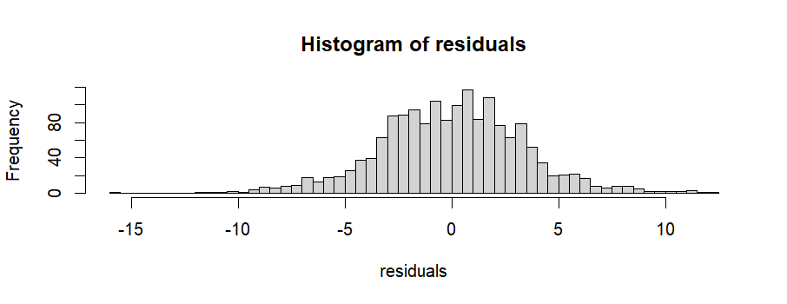
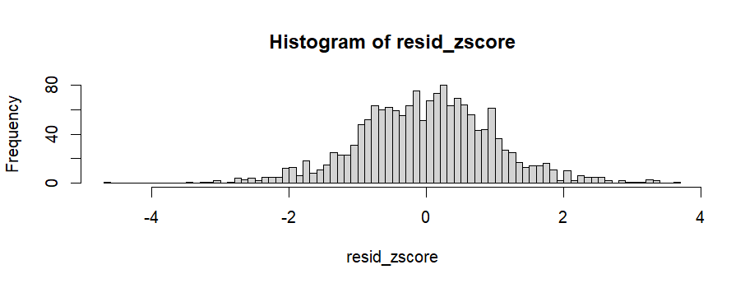
Residual Analysis

Slide 44
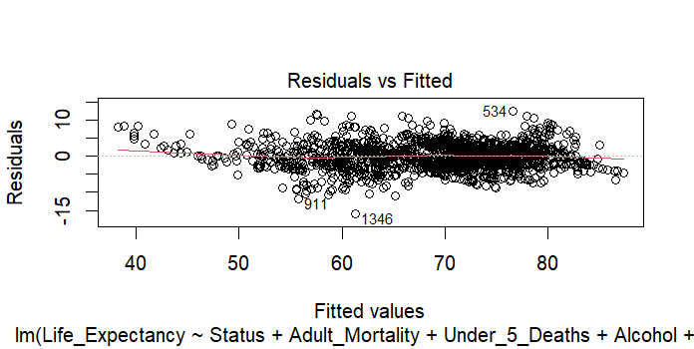
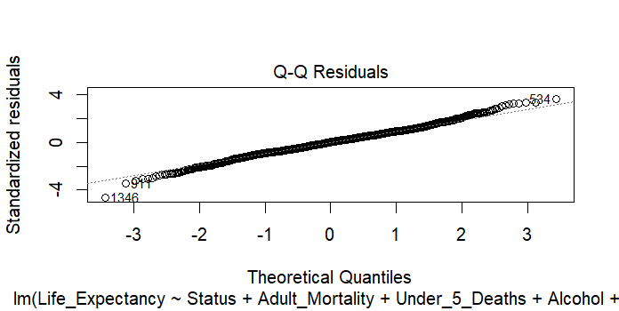
Residual Plots

Slide 45
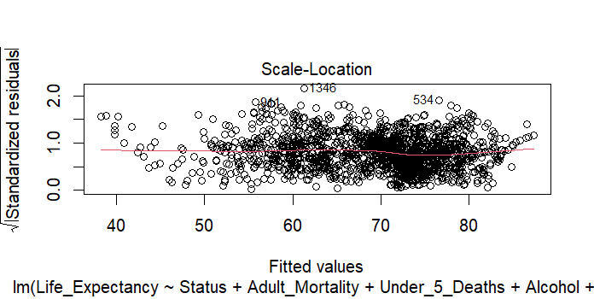
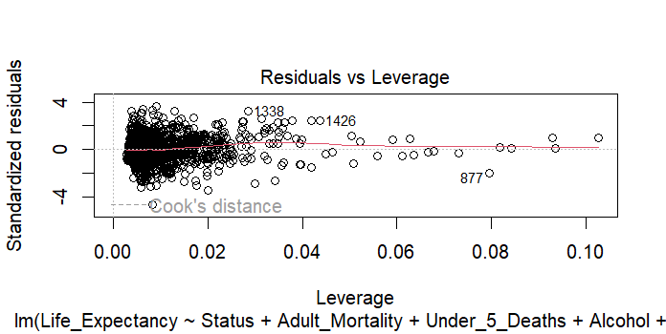

Slide 46
Test and Train Models
Dividing the data into train and test models:
Adjusted R-squared : 0.8511
> prediction <- predict(train_model, test)
> head(prediction)
4 5 8 11 16 20
64.56593 64.06244 62.87104 61.59536 58.53320 75.17245
> actual = test$Life_Expectancy
> head(actual)
[1] 59.5 59.2 58.1 57.3 54.8 76.9
> cor(prediction, actual)
[1] 0.9215453
- The correlation coefficient is close to +1 indicating a perfect positive relationship between the actual and predicted values.

Slide 47
Conclusion
The final regression model achieved has an R-squared value of 0.85 which explains about 85% of variance in predicting the Life Expectancy.
It is observed that the life expectancy increases with an increase in the socio-economic factors like GDP, Percentage_Expenditure, Income Composition of resources, Immunization Coverage(Polio, Hepatitis_B, Diphtheria) and Schooling.
There is a negative relationship with demographic variables like Adult_Mortality, Infant_Deaths and Alcohol.

Slide 48
Future Scope
The model can further be refined employing various advanced regression methods for a deeper analysis into the data.
Several other influential factors like the pollution, diet, lifestyle and more could be introduced in order to predict the average life expectancy at a better extent.
For example, the variable ‘alcohol’ is inversely proportional to the response variable. Which means, the increase in the alcohol consumption would lower the life expectancy. But, delving deep into the lifestyle, diet and other factors, there is a potential chance of maintaining the average life expectancy despite the alcohol consumption.

